Slide 1
Big Data Project: Twitter Sentiment Analysis
By Satadipa Sarkar and Deepti Joshi
Summer 2020 | Seattle Pacific University

Slide 2

Data Sources:
The project dataset contains 30 different Twitter datasets, associated with real world events from the year (2012-2016). This dataset cannot be used for commercial purposes.
Reference: https://onlinelibrary.wiley.com/doi/full/10.1002/asi.24026
The dataset comprise of only Tweet_id compressed in a GZ format. Tweeter developer account was created for API key, API Secret Key, Access token which will be used later for cloud formation stack.

Slide 3
Tools/Services used:
Python
We have used Python code to upload the raw data from our local to AWS S3 bucket.
The Python provides a pair of methods to upload a file to an S3 bucket.
The upload_file method accepts a file name, a bucket name, and an object name. The method handles large files by splitting them into smaller chunks and uploading each chunk in parallel.
Libraries used: psycopg2, boto3, requests
AWS S3
AWS S3 will be used to store the raw data files in S3, which is a secure, durable, scalable object storage infrastructure and it can connect/integrate well with other downstream services. Our data size is 1 GB.
Cost Analysis- Standard Account (Free Tier) – 5BG free for first 12 months.
RDS
Amazon Relational Database Service (Amazon RDS) is easy to set up, operate, and scale a relational database in the cloud.
It provides fast performance, high availability, security and compatibility they need.

Slide 4
Tools used:
Secret Manager
.Comprehend
EC2
Tableau
IAM

Slide 5
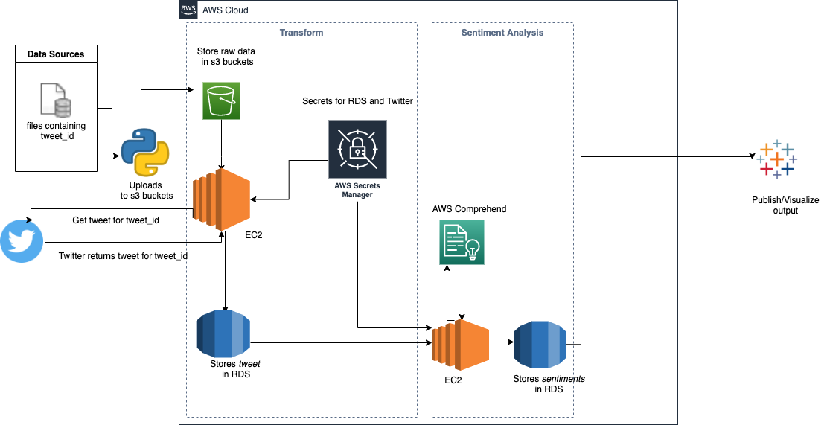
Goal: We want to do sentiment analysis on the various tweets for certain global events of importance in the past.
Architecture:
Notes:
Need to add one more S3 Bucket to send data to Lambda function

Slide 6
Downstream Flow:
The input compressed files are decompressed and uploaded to AWS S3 to be processed by downstream systems.
tweet_ids are read from the S3 bucket and corresponding tweets are fetched from Twitter API.
The tweet_ids along with the tweets are stored in RDS.
The tweets are read from RDS and AWS Comprehend is used to derive the sentiments for the tweets.
tweet_ids along with the sentiment are stored in RDS.
The sentiments are read from RDS and transformed into the required output data model- connected to Tableau.
Tableau gets the data from RDS by connetcing directly with the PostgreSQL Server.

Slide 7
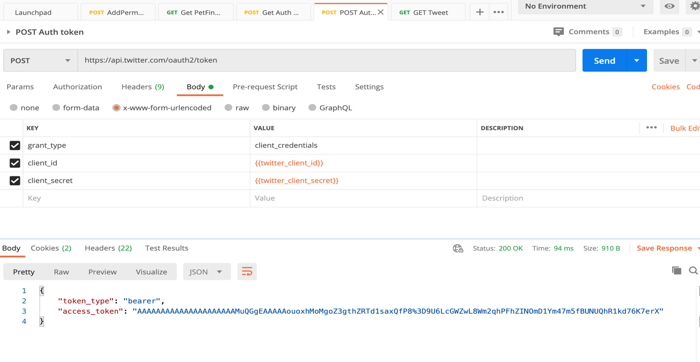
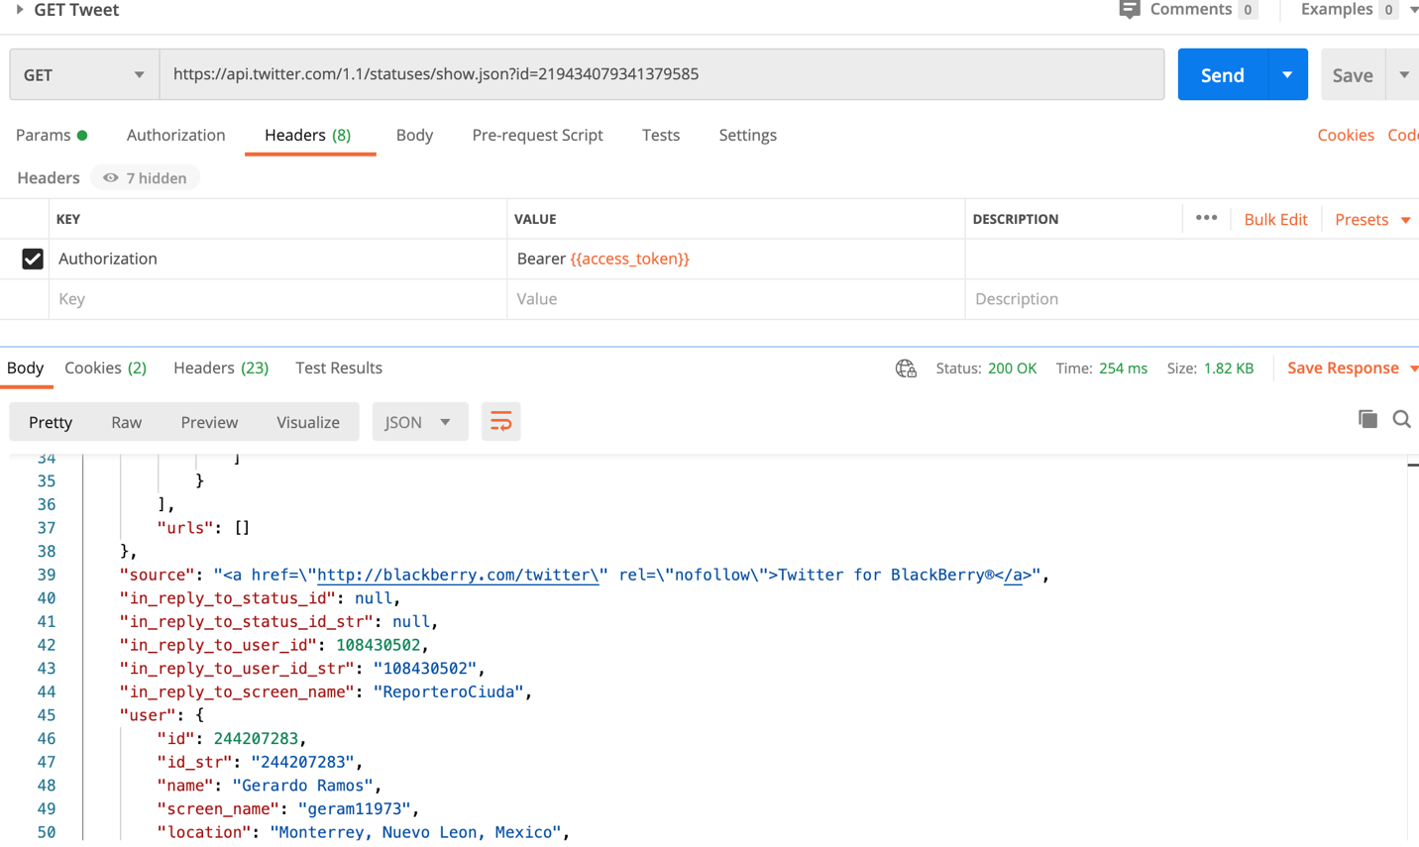
Twitter API
Created a developer account.
Create an app.
After the app is created it will send you the API Key and secret
Using Postman created a new collection called Twitter API, and created an add request: POST Auth token, with the following parameters in the body to obtain a request token
Create an add request: GET Tweet, with the following parameters in the headers to obtain a request token as shown below

Slide 8
Dataset Processing:
We will use AWS Comprehend BatchDetectSentiment for sentiment analysis -Amazon Comprehend is a natural language processing (NLP) service that uses machine learning to find insights and relationships in text. The service identifies the language of the text; extracts key phrases, places, people, brands, or events; understands how positive or negative the text is; analyzes text using tokenization and parts of speech; and automatically organizes a collection of text files by topic
No machine learning models needed to build, train, or deploy.
Pricing:

Slide 9
Python script steps:
Unzip the tweet_id files with .gz extension and upload to S3.
Created a table in RDS with the following table schema.
For each file from S3, load tweet_id into RDS table in batch.
For each unprocessed tweet_id, fetched the tweet, updated row in PostgreSQL with the tweet and updated the workflow_status =”TWEET_FETCHED”
Get batch of tweet with workflow_status “TWEET_FETCHED” and call AWS Comprehend for sentiment analysis.
Stored the response from AWS Comprehend into RDS and updated the status of the row to “COMPLETED”.
:

Slide 10
Why we did not do run all the tweet_id’s using AWS Comprehend?
Number of tweet_id = 4.02 million
Approximate character count = 300
Approximate units per tweet =300/100 = 3
Chargeable units = 12.06 million
Cost up to 10 million units = 0.0001/unit
Free tier =50K units
Billable units = 12.06 million -50,000 = ~12 million
Approximate cost of the project = 0.0001 * 12 * 10^6 = $1200

Slide 11
Why EC2 not Lambda?
EC2 is cheaper and in our case t2.micro is free.
Lambda does not support most of the libraries. And installing different libraries was difficult and cumbersome using Layers.
The development could be done on personal laptop and same code was executed on EC2.
Development and deployment is much more streamlined.
No need of ant special code, while Lambda requires special entry methods which is hard to replicate on local machine.
No way to connect directly to GitHub repository.

Slide 12
Why RDS and not DynamoDB? ?
It is a relational database.
DynamoDB is good for writing once and reading multiple times on the primary key. However, in this project the workflow was on reading the status of the record.
Relational database is superior in read -write scenario. In this project (2 Reads and 3 Writes).
Easier to connect with data visualization tools (Tableau).
RDS cost is lesser.

Slide 13
Lambda vs Stream Architecture
Batch Processing can compute arbitary sources and arbitary data with the queries that goes out of date for few hours.
Lambda architecture involves both batch and stream processing which involves complex queries and incremental algorithm.
In our project, we don't have use cases of streaming/real time data and analysis. It is easier and cheaper to do batch processing and change the algorithm when needed. Example we don't want to process the sentiment of the tweets and re-tweet in real time.
It is simple, easy to understand and completey scalable and we need to think about data and functions on that data.
Batch system is consistent, almost human fault tolerant .

Slide 14
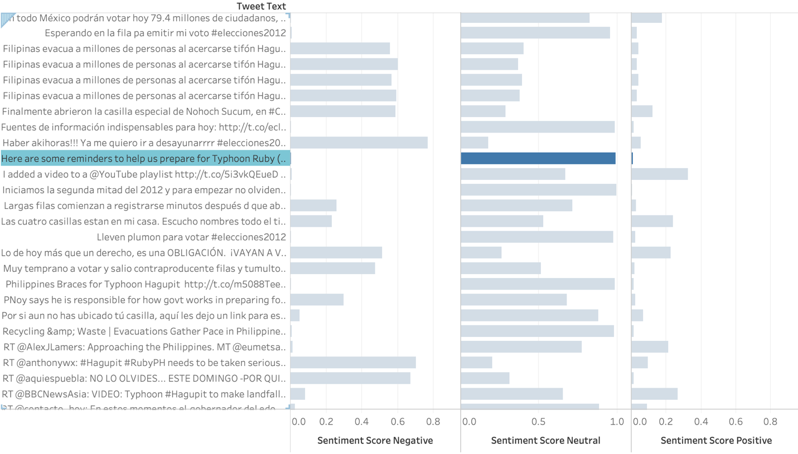
Data Visualization
Connect to a server :
Select PostgreSQL
Go to RDS:
Select Endpoint: rds-postgres-free-tier.cjrnyh2qgdds.us-west-2.rds.amazonaws.com
Database: ﻿rds-postgres-free-tier

Slide 15
Security
AWS Cloud Adoption Framework provides the following best practice capabilities from a technical security perspective:
IAM: Used to define, enforce, and audit user permissions across AWS services, actions, and resources. We are controlling IAM role by limiting the root user to 1.
Infrastructure Security: Public access is blocked for the s3 buckets. Only bucket owner can access it.
Data Protection (encryption and tokenization): AWS Secret Manager to securely store and access Twitter API access tokens and RDS credentials.
Incident Response: While uploading raw data in S3 with Python script, we had a security incident. The python code contained AWS secret key which got committed in git repository, as a result the secret token, key was visible to public. The AWS team raised a security incident and sent an email about the issue. As a measure we removed the secret key from the code, all access key including root and IAM User created during or before the account compromised was deleted and recreated.
Privacy:
PII data is being handled through Amazon Macie Classic, which uses machine learning to classify sensitive data such as PII. It gives the user a visibility into how such data is being moved in the system.
Data Storage timeline: The data will be stored in S3 buckets until mid-August – end of this quarter.

Slide 16
How does this fit into your long-term vision
How do people respond to events/anomalies:
From the perspective of various segmentations, i.e. issue areas such as economic, social, political, health; or by location i.e. state, country, etc.
E.g. can we predict how people will react to a certain event, and can this inform our understanding of how they may behave in upcoming elections?
From the perspective of keywords: people, hashtags (movement), stuff
E.g. who are they blaming, source of the problem, public perception?
Tracking public perception over time:
Are we more optimistic/pessimistic/the same?
Which populations (by location?) have the strongest opinion:
Is change enacted amid all those raising their voice? (i.e. how does government respond)

Slide 17
Scope of Improvements
Cloud formation can be used in future for scaling- It can be definitely be useful when we are scaling out to multiple regions, in our case it is only one region-US-West-2. We wanted to learn the nitty-gritty of various services and components used by hand.
Leverage Amazon Kinesis Data Firehose to easily capture, prepare, and load real-time data streams into data stores, data warehouses, and data lakes

Slide 18
Questions?

